Slide 1

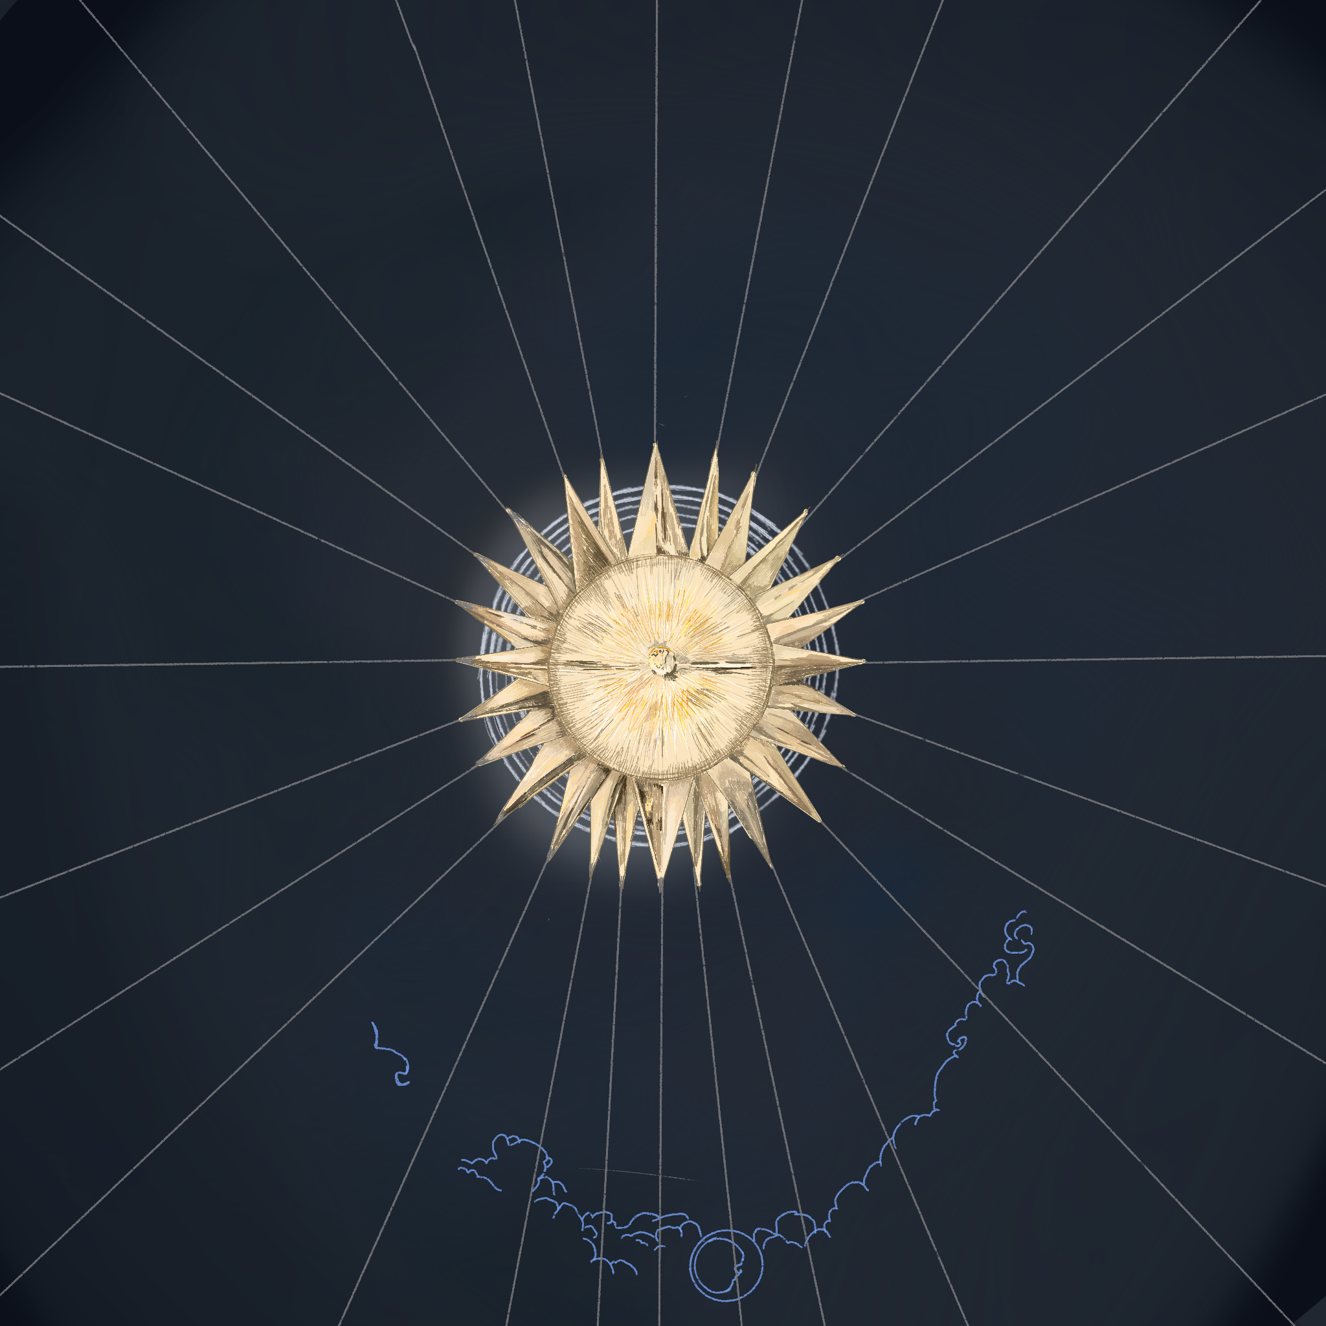
Constellations of Us inspired
Interactive Installation

Slide 2
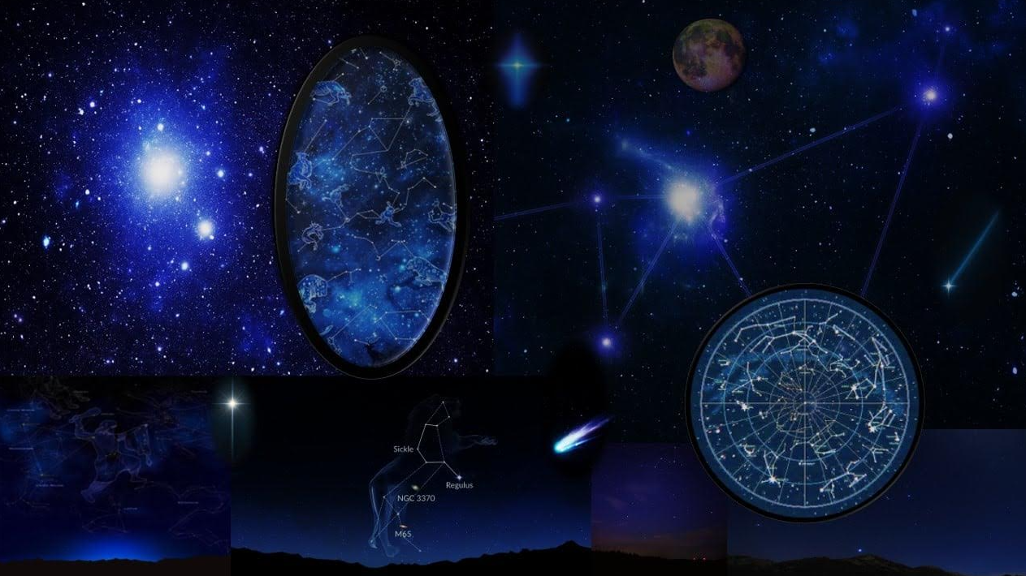


Interactive Installation - Overall Vision
Become part of the stars
Our vision is to create an immersive and interactive installation that allows the public to create a unique starscape.
The aim is for it to allow families and groups to experiment with the visuals and sounds that can be created with their body position and collaboration.
Possible art styles for animated visuals. The use of clip studio and other software to animate stars and space artifacts.

Slide 3

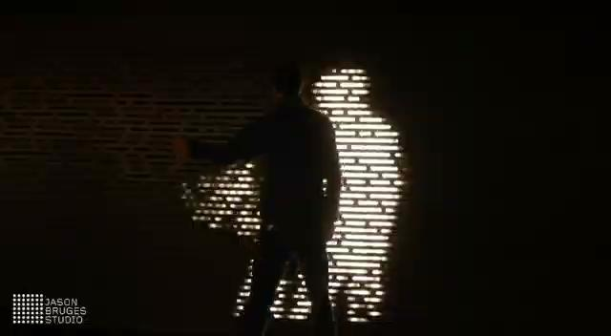
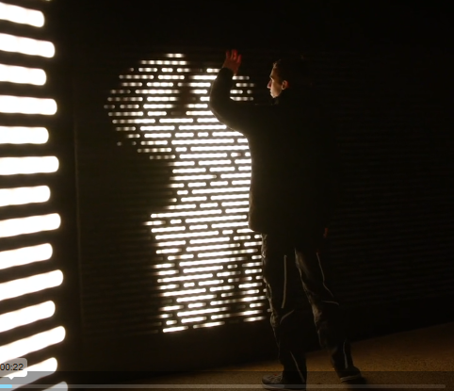
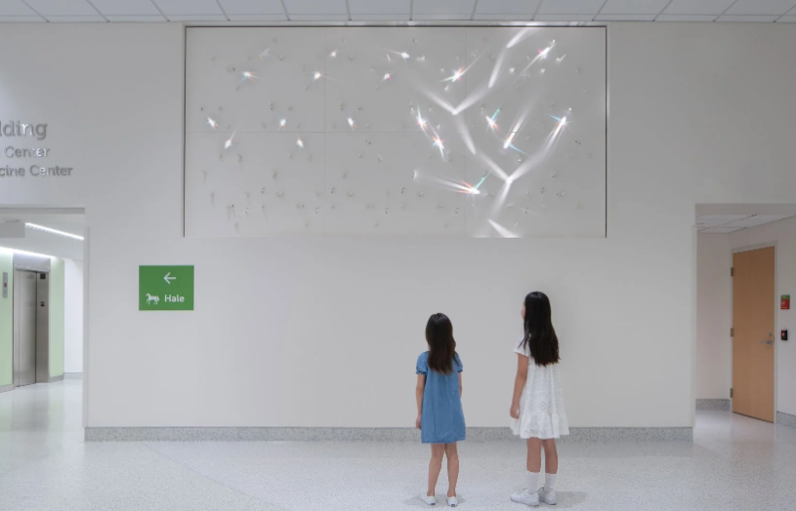
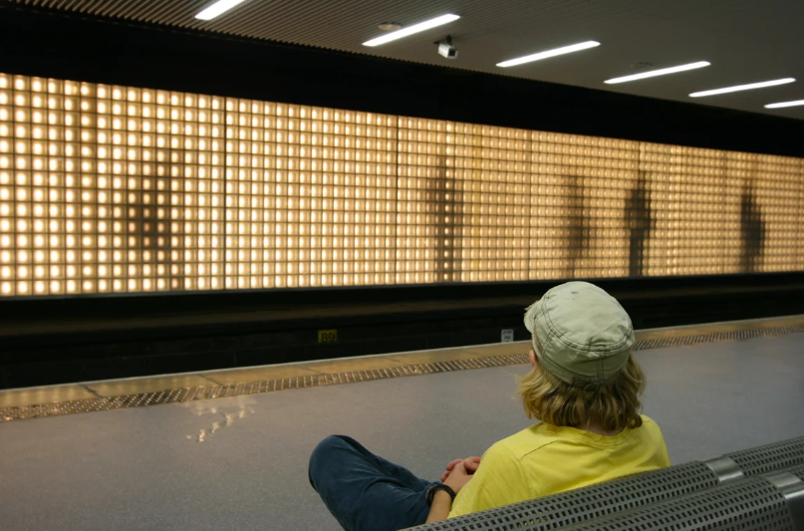
Constellations of Us
Interactive Installation - Places of inspiration
Our installation should evolve based on active participants whose bodies trigger changes in the artwork.
As an example; Jason Bruges is a multimedia artist who creates bespoke installations, often responding to the presence of the public.
These examples use LEDs which isn’t our plan, but are successful examples of interaction based artwork.

Slide 4

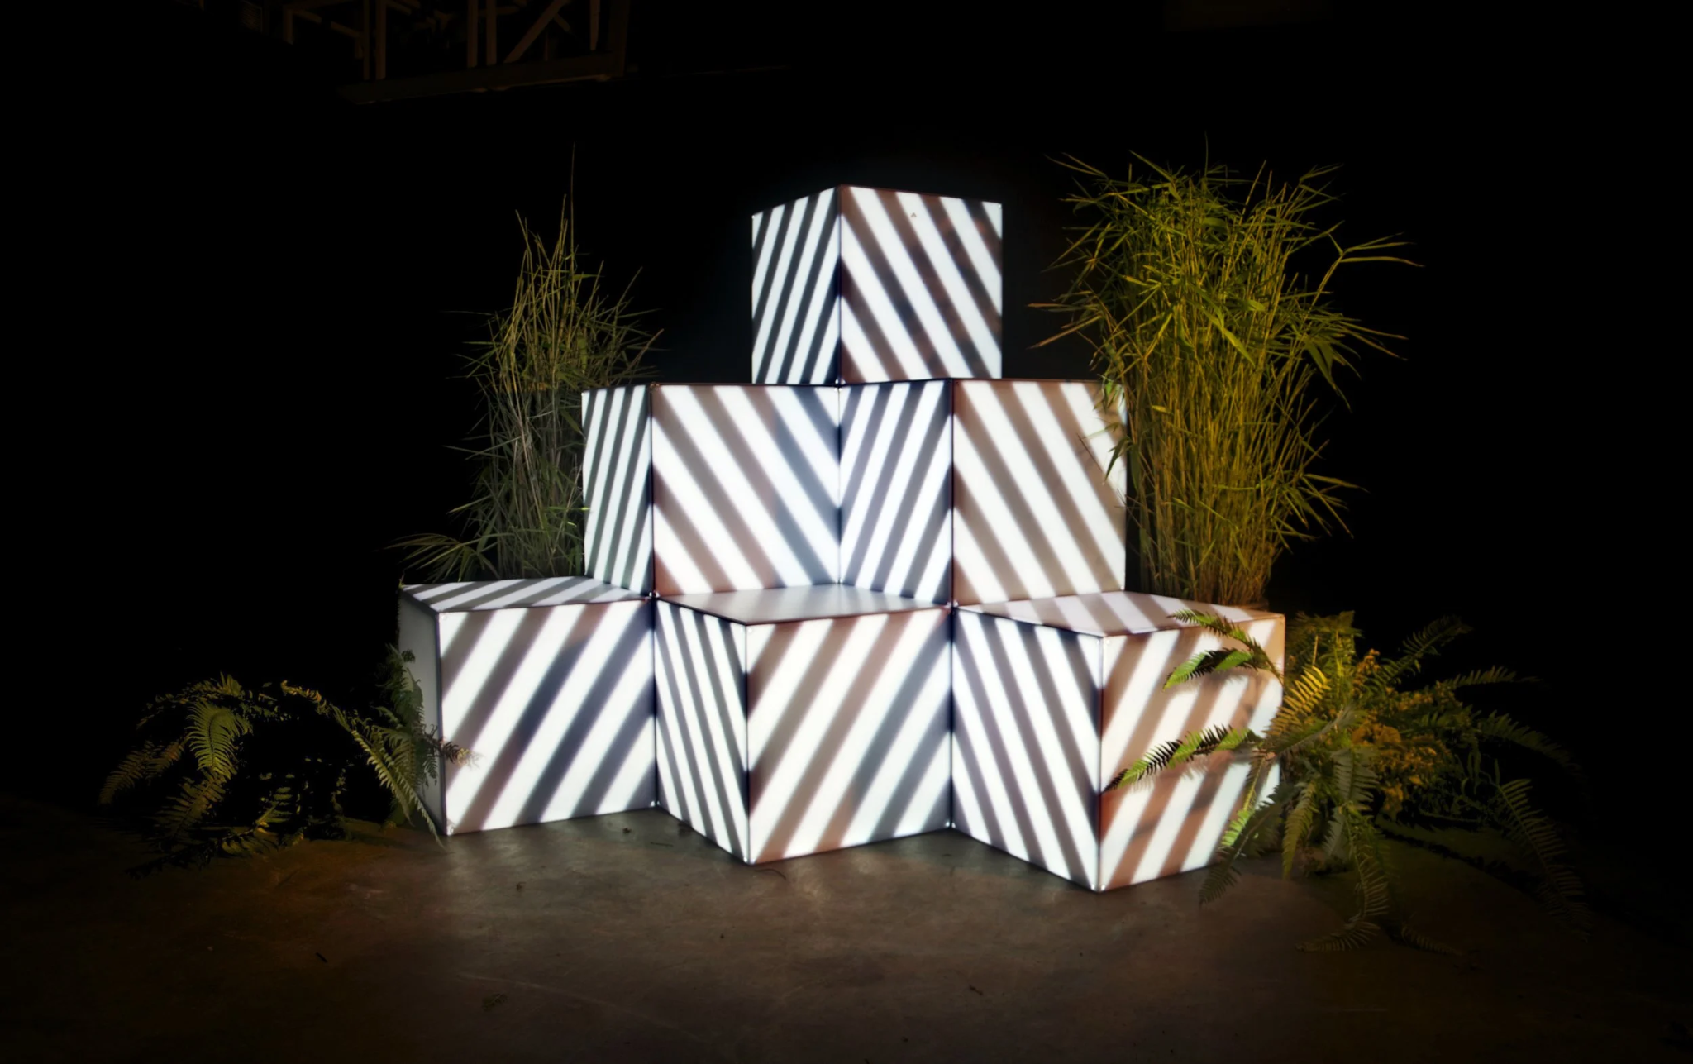
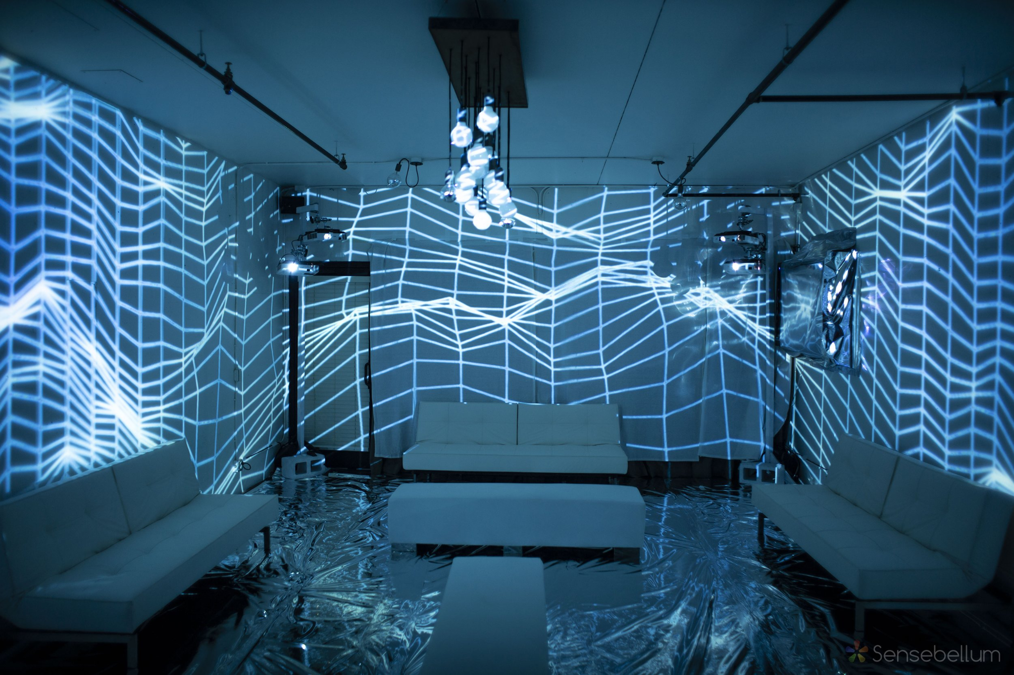
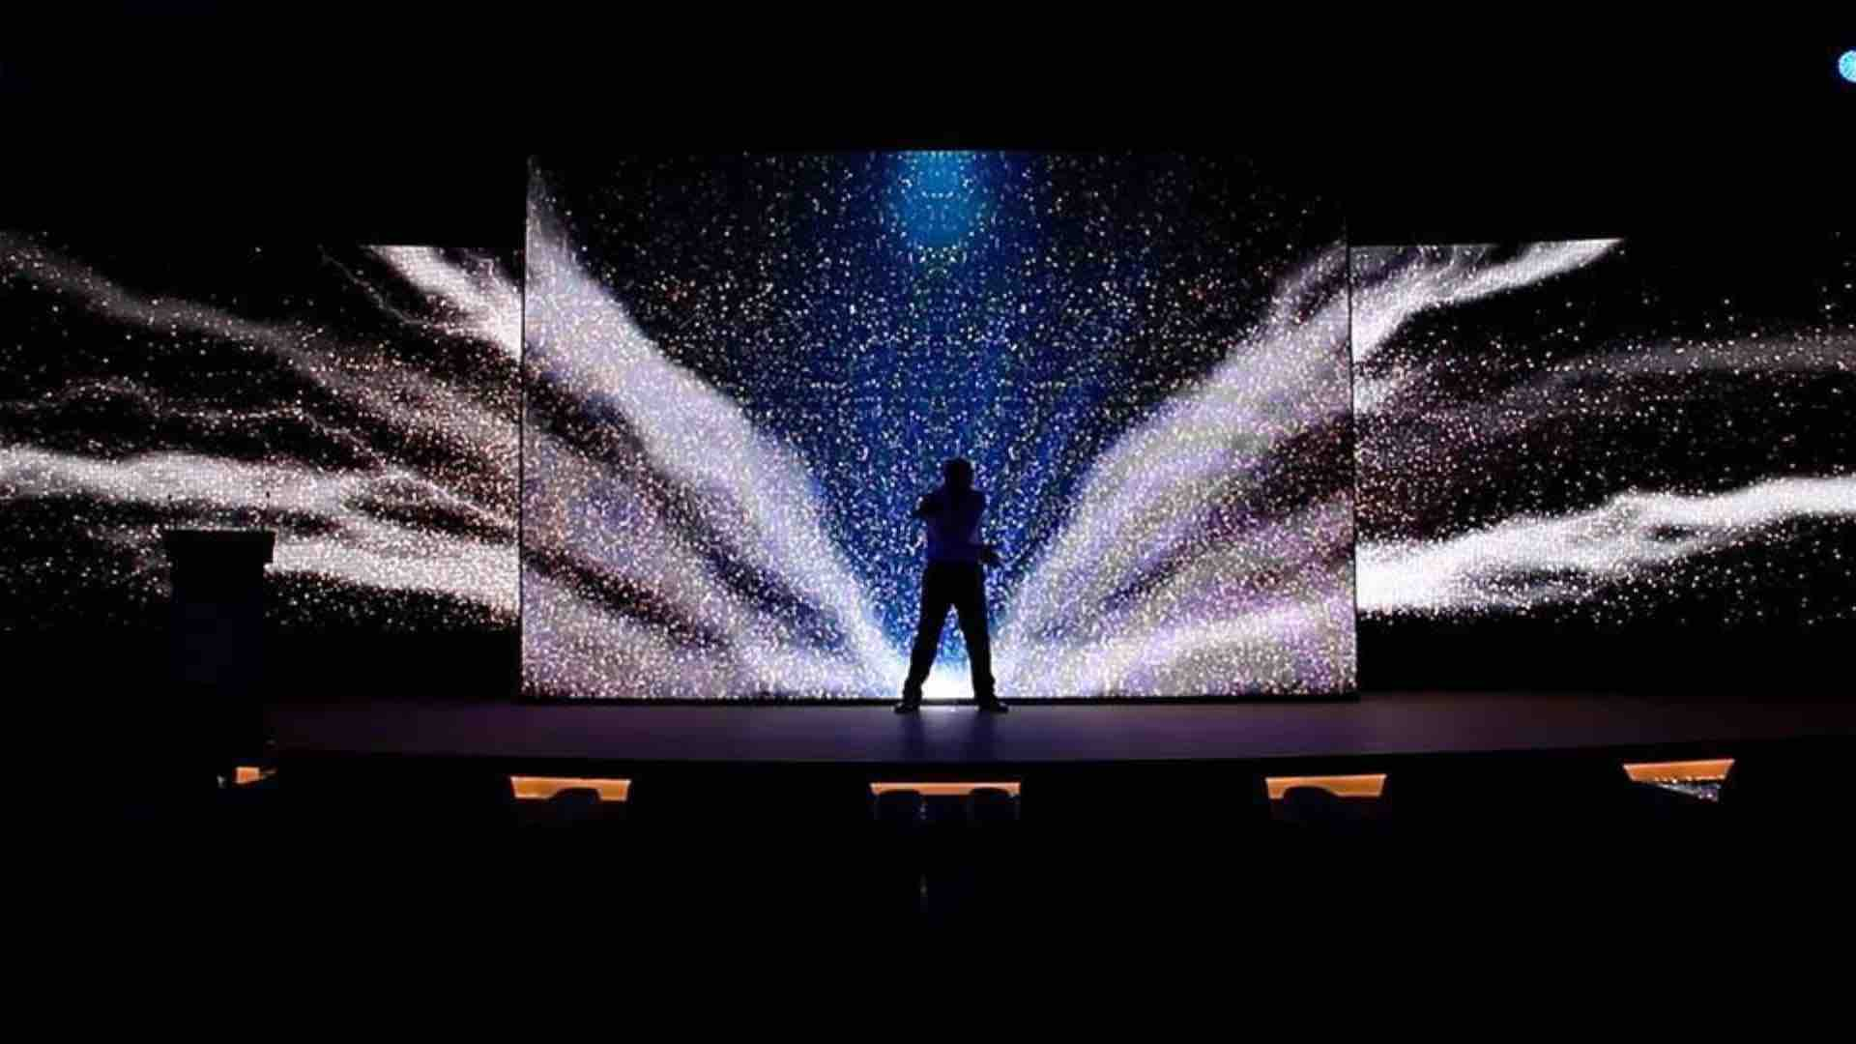
Interactive Installation - Projection
Projection mapping allows the visuals to be played on any surface, this means we can set up an installation in different ways.
Could take up sides of a room, a singular wall/projector screen or projected onto object setups. Could even be projected outside the building? Sensing people entering and exiting the building.

Slide 5
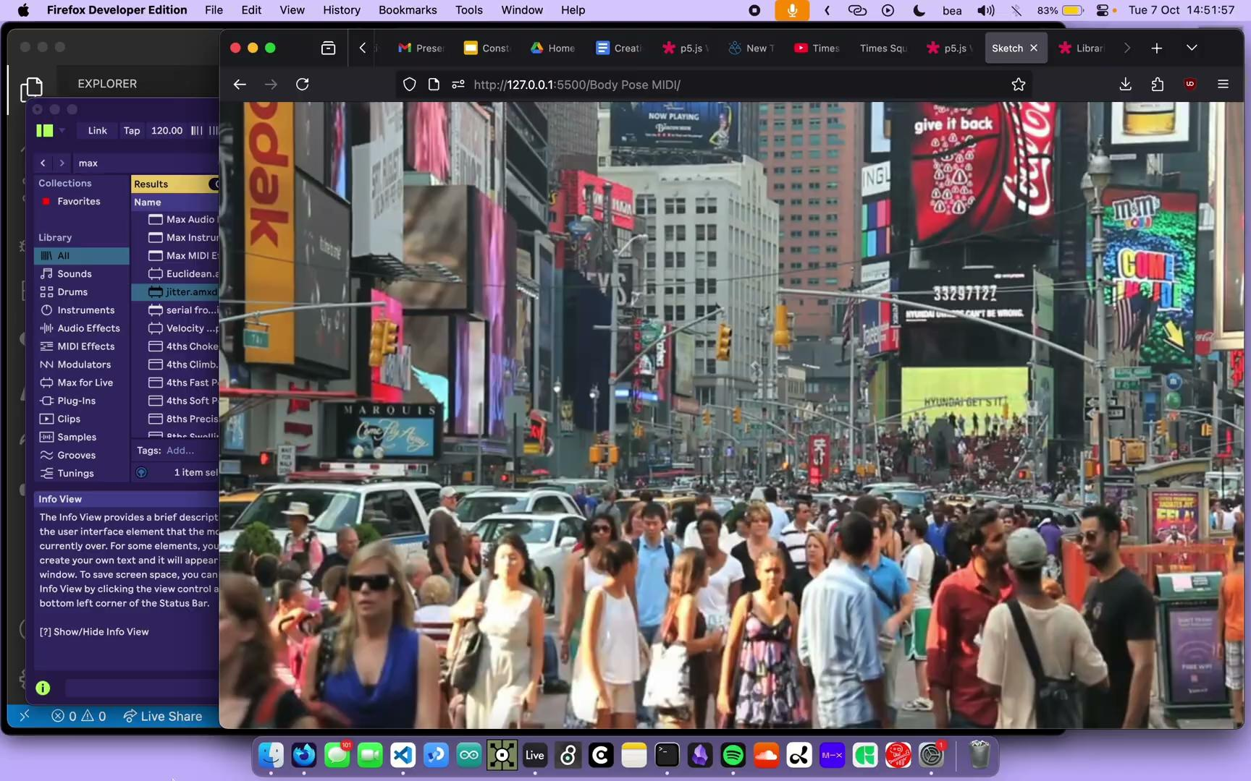
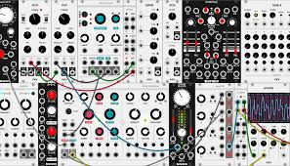
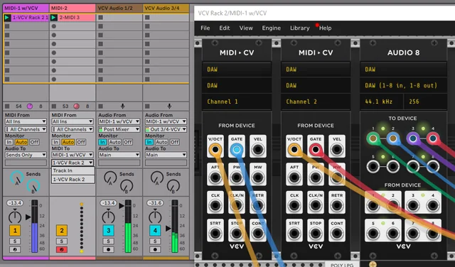
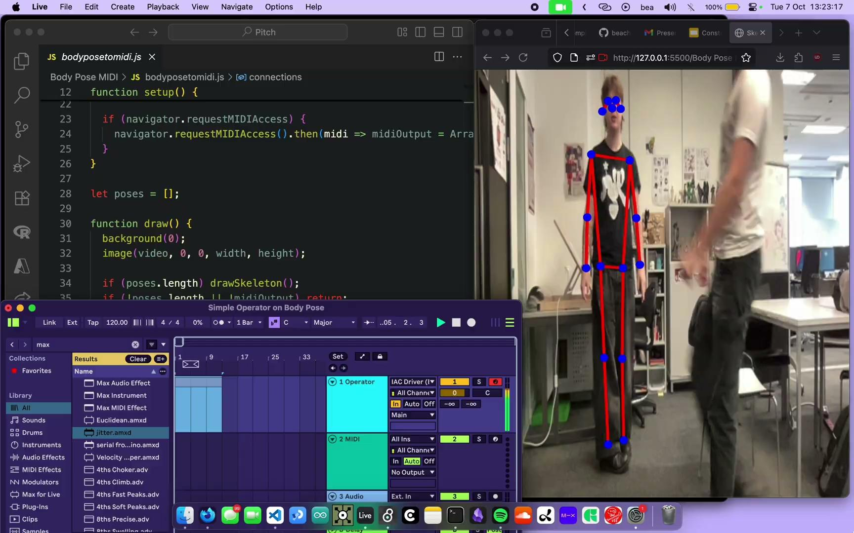
Sound
Sound is generated in JavaScript using p5.js and ml5.js. A camera tracks body position and sends it over the web MIDI library. This data is then received in Ableton Live and directly creates MIDI notes so sound generation is happening in real time based on users body
position.

Slide 6
Constellations of Us
Team Roles
To ensure we can complete the project on time it is important to split the concept into smaller more manageable tasks that can be worked on simultaneously by different members of the team.
Bea - Focus on sound and body interaction & promotional material
Fliss - Focus on body interaction and ensuring cohesiveness across all fronts & promotional material
Conor and Noa - Visuals (animation) & social media
Project Schedule
Early Stage Project Schedule: Using agile work methodology to produce a working prototype as quick as possible
Month | Task | Notes
Month 1 | Research, ideation, exploration and prototyping Social media behind the scenes content. | Solidifying the idea and begin a mock-up of the final concept - testing 3D materials for the projection setup, creating concept art and finalising the design language of the piece.
Month 2 | Refining and further development. | Finalise physical spacing and develop more promotional material.

Slide 7
Constellations of Us
Intended Audience
The installation should peak the public's interest so that they are curious enough to interact and play around with movement and collaboration.
The hope is for kids and adults alike to enjoy the experience of the piece so it must be to accessible to people of all ages:
Easy to understand (intuitive)
Playful and intriguing
Engaging
Responsive
Thanks for Listening!

